Slide 1
Applied Data Analytics Analyzing the TRUMP effect on Amazon, Google, Meta, and Tesla stocks
Elaine da Silva
April, 2025

Slide 2
Project Overview
Goals:
* Predict stock prices
* Analyze Trump impact
* Report insights
Rationale: personal curiosity to explore stock market trends triggered by political events, such as Trump's victory and his relationship with the business leaders.
Scope:
* Gather daily data from API
* Train a model to predict close price
* Report insights in Power BI

Slide 3
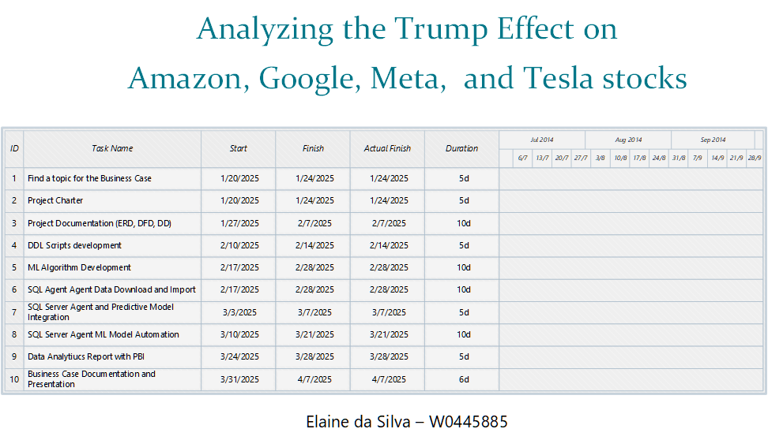
Gantt Chart

Slide 4
Tools
PLANNED | USED
VISIO (ERD, DFD, and GANTT) | VISIO (ERD, DFD, and GANTT)
EXCEL (Data Dictionary) | EXCEL (Data Dictionary)
SSMS / SQL Server (DDL/DML scripts, Data Storage) | SSMS / SQL Server (DDL/DML scripts, Data Storage)
R (Data Manipulation, Analysis, and ML) | R (Data Manipulation, Analysis, and ML)
SSIS (Automation, and Integration) | SQL Server Agent (Job, Automation, and Integration)
Power BI Report (visualization) | Power BI Report (visualization)

Slide 5

Business Case Documentation
ERD
DFD (Level 0 and Level 1)
Data Dictionary
DDL Code
Gantt Chart

Slide 6
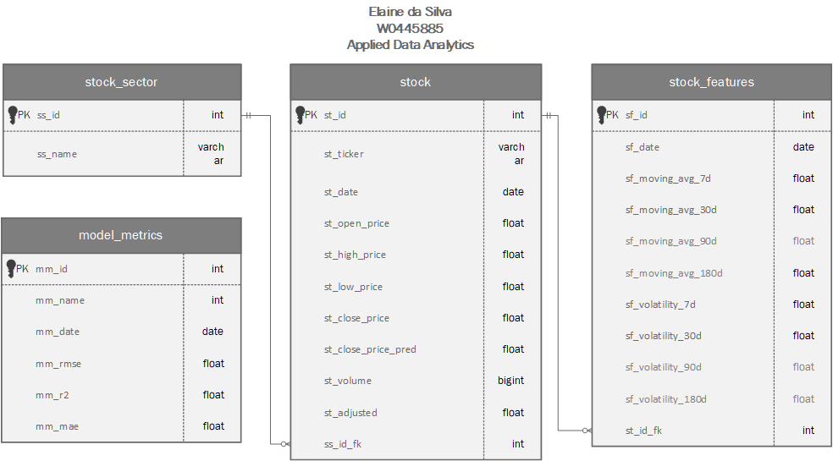
Entity Relationship Diagram

Slide 7
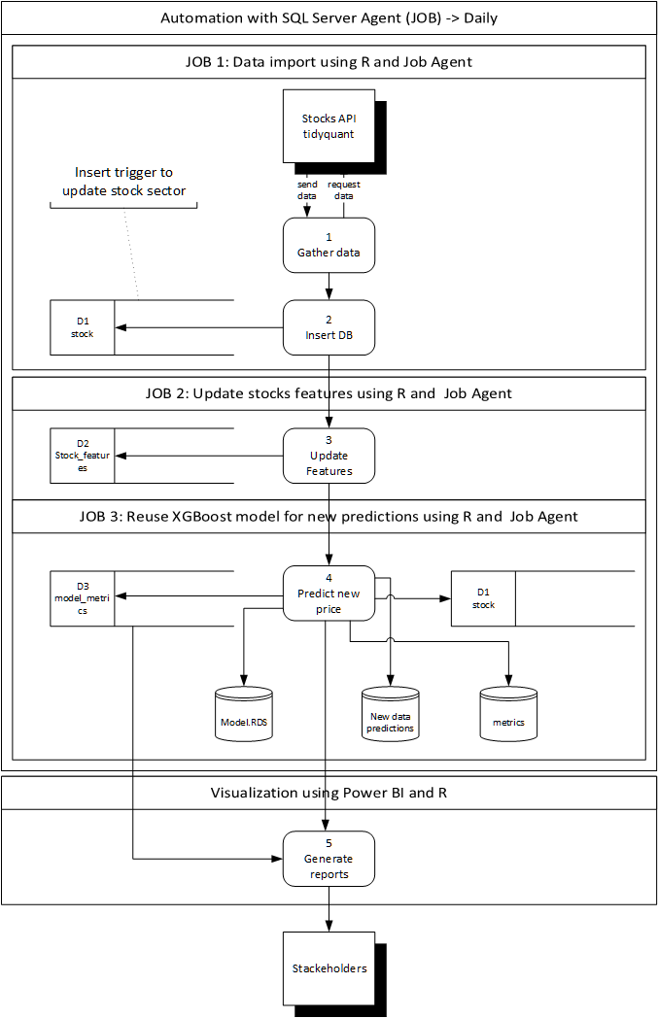
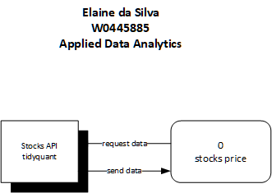
Data Flow Diagram

Slide 8
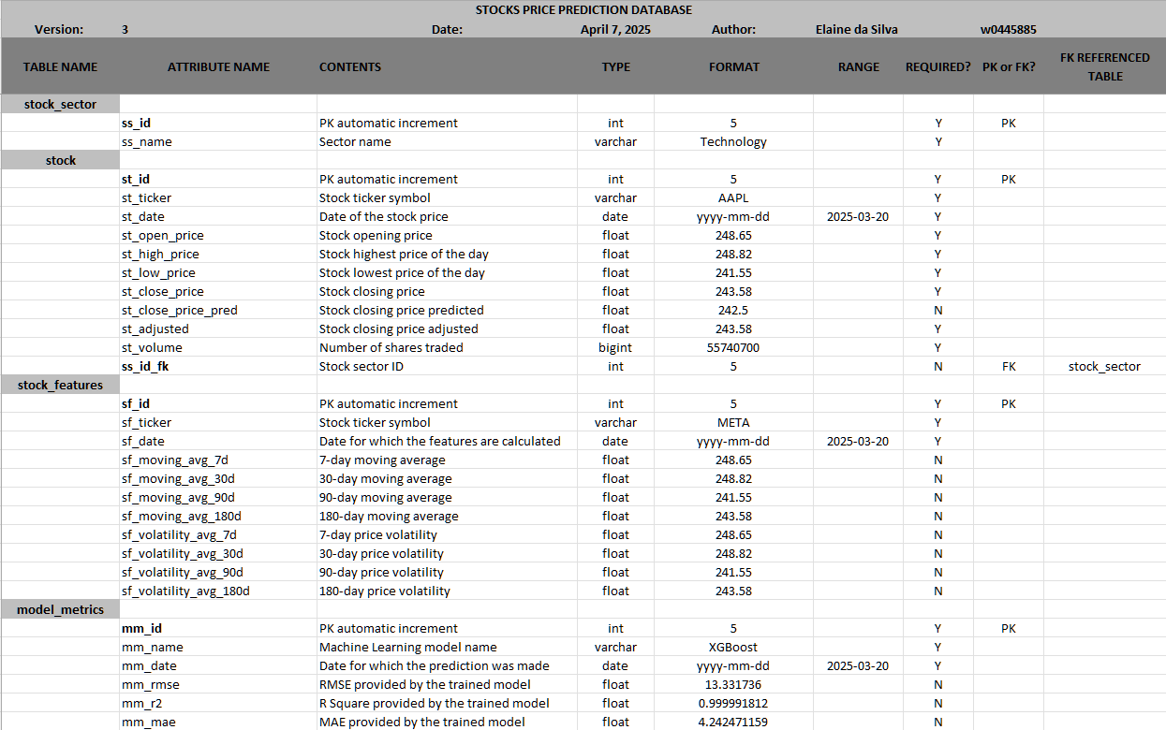
Data Dictionary

Slide 9
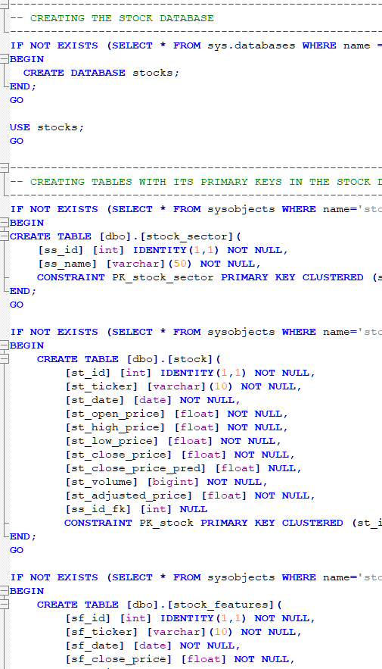
DDL Code
DDL Stocks Data API Database
Scripts to create the Stocks Database
The database will be used to store and track data from Stocks
It will be updated daily using an automated script to gather the data from the API
API tidyquant
table creation order: stock_sector, stock, stock_features, model_metrics

Slide 10
Scripts used for the project
data_import_insertDB.R: import data from tidyquant API and insert it into DB.
features_calculations.R: calculate moving average and volatility after new download.
model_prediction_XGB.R: train the XGBoost model and save it to disk.
update_Y_column.R: update the st_close_price_pred with the model created.
model_new_predictions_XGB.R: make daily predictions using the new data downloaded.
DDL/DML SQL:
Create database, create table, keys,
Trg_insert_sector_id: trigger on STOCK. SS_ID_FK table to update the sector id.
Vw_stock: view with stock data, profitability and trend calculations, split the st_date to have the weekday, dayofmonth, dayofyear, etc.

Slide 11
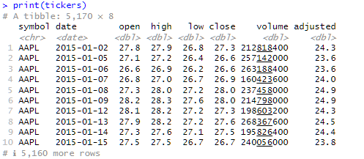
API data structure

Slide 12
Automation SOLUTION
API Data Import
XGBoost Regression model builder (Training & Saving)
Data Transformation Code
Reusing XGBoost Regression model for New Predictions
Automation Screenshots
Live Demo

Slide 13
API Data ImporT
JOB 1 - STOCKS - Download API and Insert DB
(tidyquant)

Slide 14
1. API Data Import: overview
R Script: data_import_insertDB.R
API library: tidyquant
Scheduler tool: SQL Server Job Agent
Job name: JOB 1 – STOCKS – Download API and Insert DB
Get stock data from Magnificent Seven (D-1 ):
Apple, Amazon, Google, Meta, Microsoft, Nvidia, and Tesla
Get Dollar, Nasdaq, and S&P500 data (D-1)
D – 1 because tidyquant doesn’t provide real time data as yfinance

Slide 15
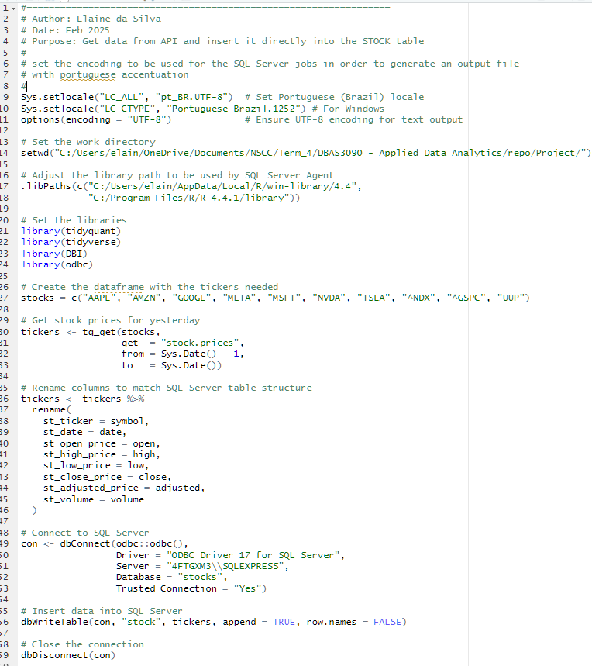
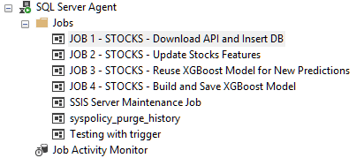
2. API Data Import: script and job list

Slide 16
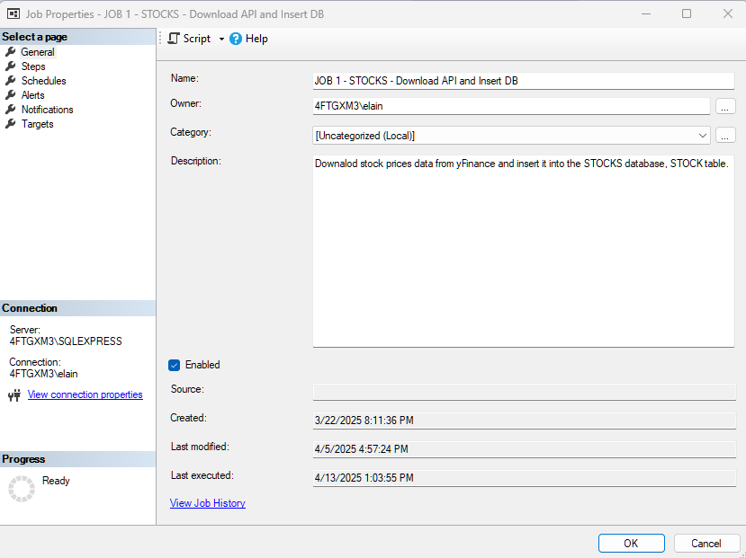
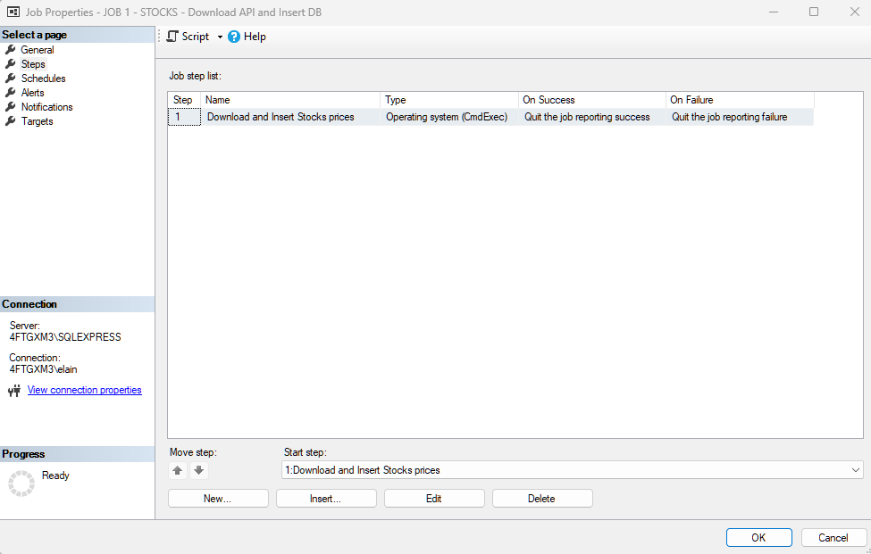
3. API Data Import: Job setting
Job page 1: General Information
Job page 2: Steps

Slide 17
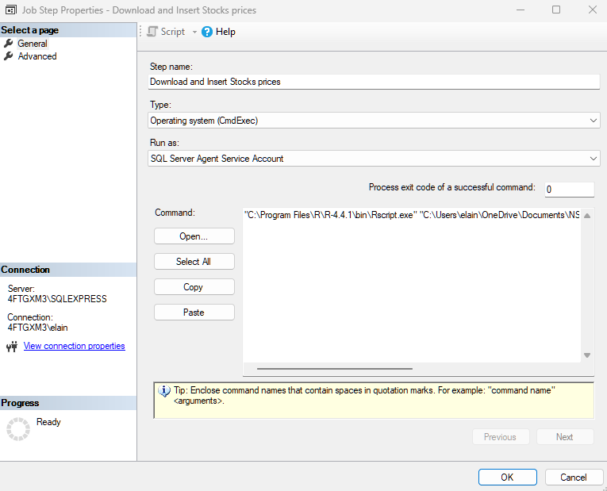
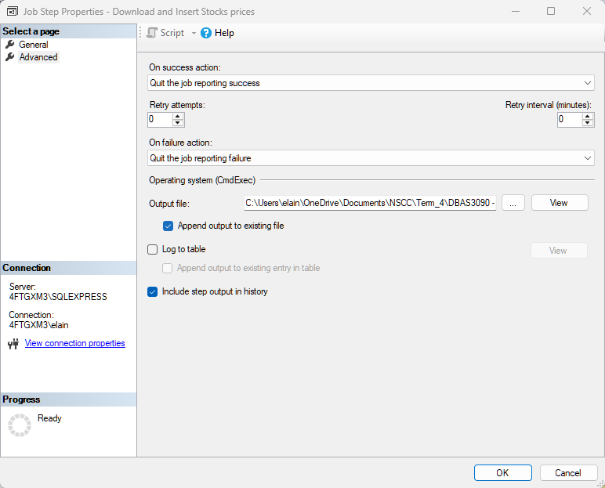
4. API Data Import: Job steps
Job Steps: General Information
Rscript.exe and Script.R
Job Steps: on Success / on Failure actions
Output files .TXT

Slide 18
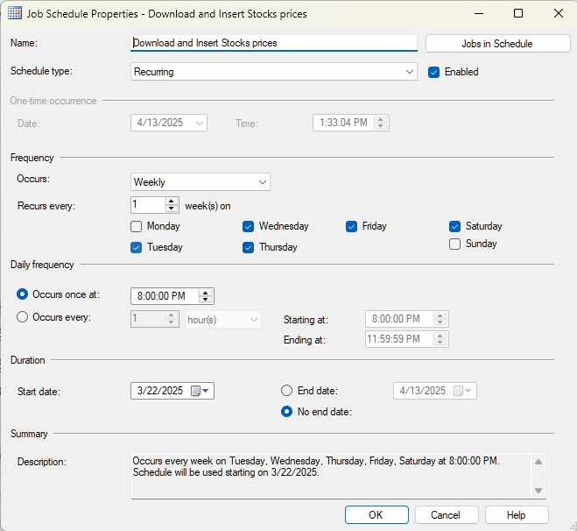
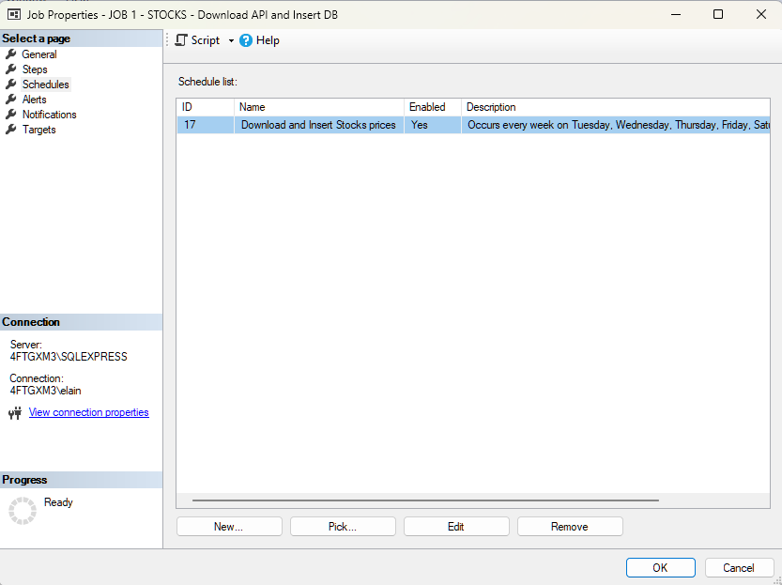
5. API Data Import: Scheduler
Job Scheduler: General Information
Job Scheduler: execution date and time
Daily => from tuesday to saturday (D – 1)

Slide 19
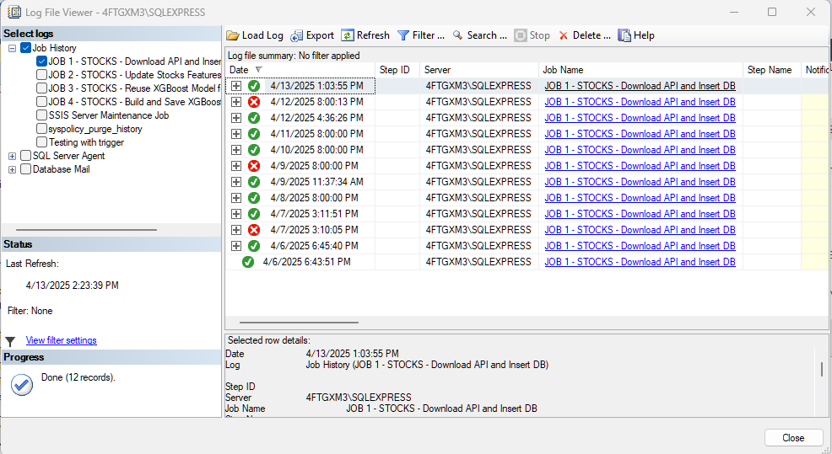
6. API Data Import: job history

Slide 20
API Data ImporT
JOB 1 - STOCKS - Download API and Insert DB
(automation screenshots)

Slide 21
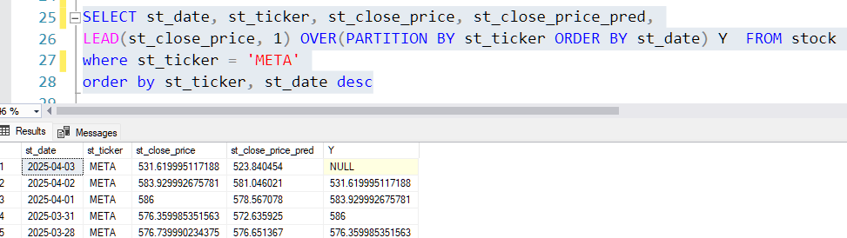
1. API Data Import Last day before downloading (April 03)

Slide 22
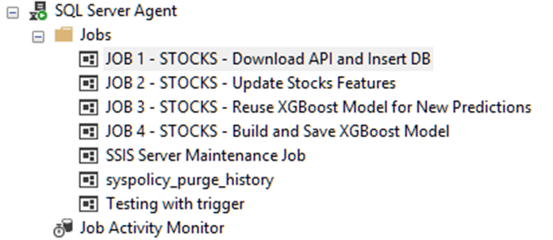
2. API Data Import: job list

Slide 23
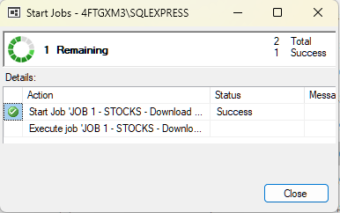
3. API Data Import: execution

Slide 24
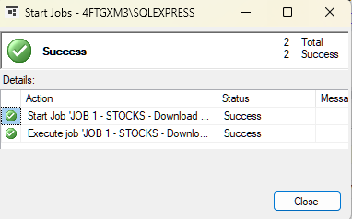
4. API Data Import: conclusion

Slide 25
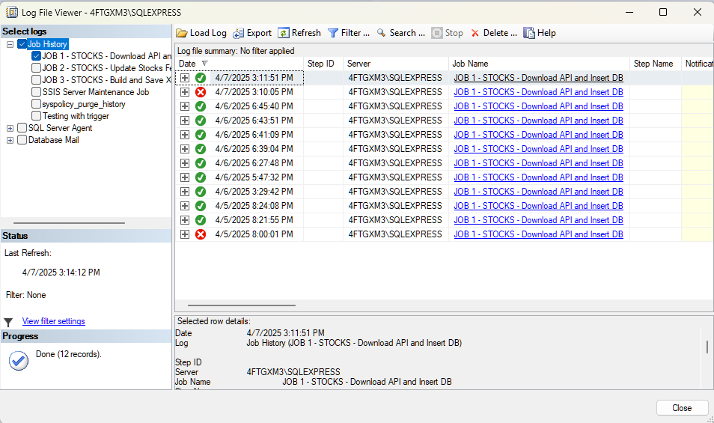
5. API Data Import: job history

Slide 26
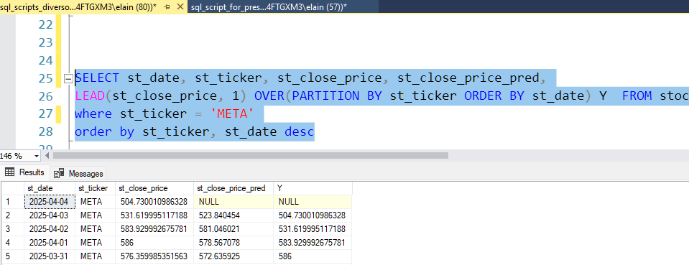
6. API Data Import Last day after downloading (April 04)

Slide 27
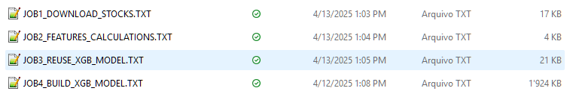
7. Jobs outputs
JOB1_DOWNLOAD_STOCKS.TXT
JOB2_FEATURES_CALCULATIONS.TXT
JOB3_REUSE_XGB_MODEL.TXT
JOB4_BUILD_XGB_MODEL.TXT
Job Steps: on Success / on Failure actions
Output files .TXT

Slide 28
XGBoost Model Training and Saving
JOB 4 - STOCKS - Build and Save XGBoost Model (on demand)

Slide 29
XGBoost model builder: overview
R Script: models_predictions_XGB.R
Job name: JOB 4 – STOCKS – Build and Save XGBoost Model (on demand)
Algorithm: XGBoost (Regression)
Libraries: XGBoost, caret, DBI, odbc, dplyr, and ggplot2
DB connection/manipulation: DBI and odbc
Train (80%): xgb.train()
Test (20%)
Evaluate model: postResample()
Save model: saveRDS(model_xgb, "./outputs/final_model_xgb.rds")

Slide 30
XGBoost model builder : stock table
st_id => stock table ID (PK) (excluded from features)
st_ticker => symbol / stock name
st_date => date
st_open_price => opening price
st_high_price => highest price
st_low_price => lowest price
st_close_price => closing price (target)
st_close_price_pred => Y
st_volume => traded volume
st_adjusted_price => adjusted price
ss_id_fk => stock sector id (FK) (excluded from features)

Slide 31
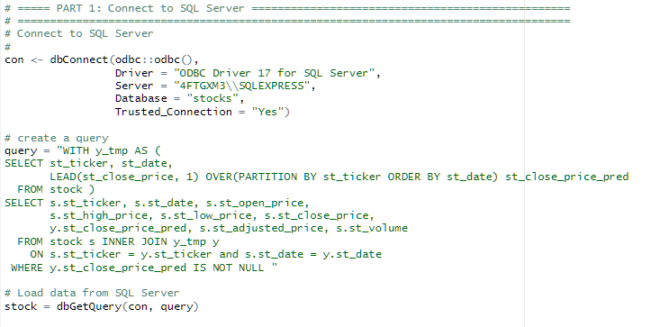
XGBoost model builder 1. Getting the data

Slide 32
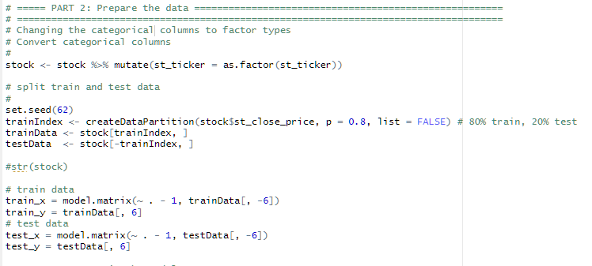
XGBoost model builder 2. Preparing the data

Slide 33
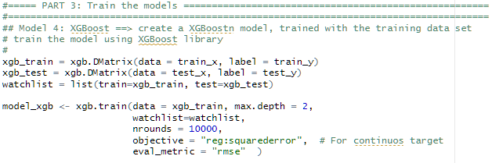
XGBoost model builder 3. Training the model

Slide 34
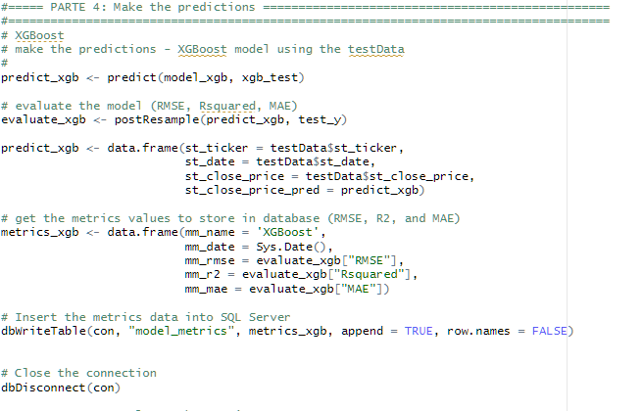
XGBoost model builder 4. Making predictions and saving metrics to DB

Slide 35
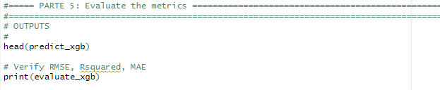
XGBoost model builder 5. Evaluating metrics

Slide 36

XGBoost model builder 6. Saving model to disk

Slide 37
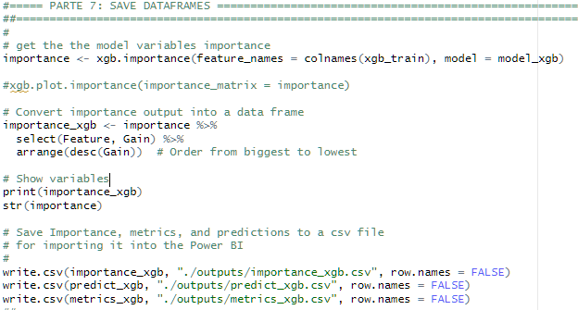
XGBoost model builder 7. Saving data frames to csv

Slide 38
REUSING XGBOOST Model FOR New PredictionS
JOB 3 - STOCKS - Reuse XGBoost Model for New Predictions

Slide 39
Reusing XGBoost model: overview
R Script: models_new_predictions_XGB.R
Job name: JOB 3 - STOCKS - Reuse XGBoost Model for New Predictions
Algorithm: XGBoost
Libraries: XGBoost, caret, DBI, odbc, dplyr, and ggplot2
DB connection/manipulation: DBI and odbc
Evaluate model: postResample()
Save model: saveRDS(model_xgb, "./outputs/final_model_xgb.rds")

Slide 40
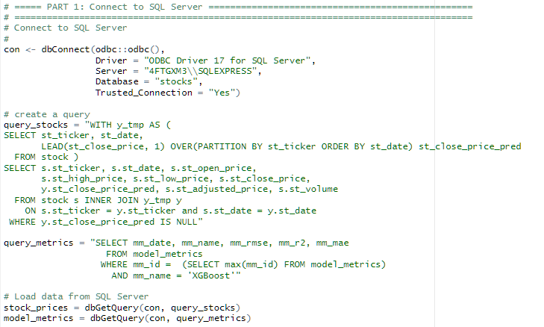
Reusing XGBoost model 1. Getting the data

Slide 41
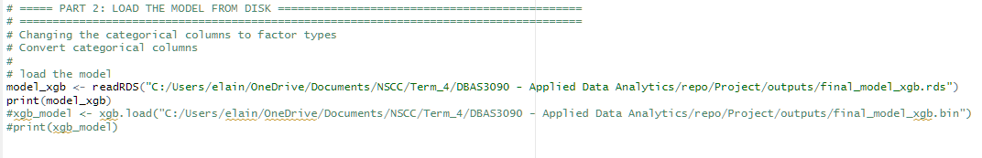
Reusing XGBoost model 2. Loading the model

Slide 42
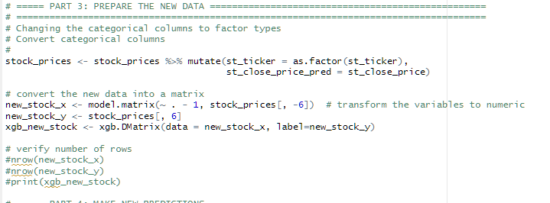
Reusing XGBoost model 3. Preparing the data

Slide 43
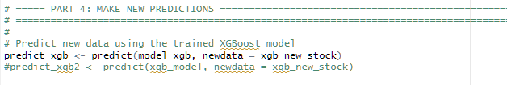
Reusing XGBoost model 4. Making new predictions

Slide 44
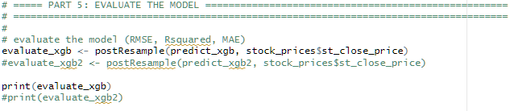
Reusing XGBoost model 5. Evaluating metrics

Slide 45
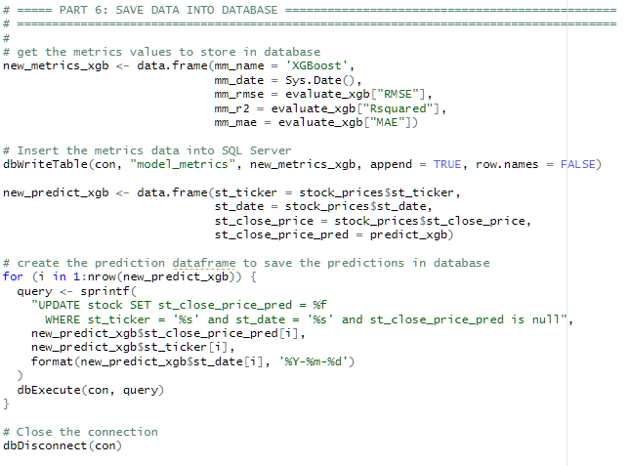
Reusing XGBoost model 6. Saving metrics and predictions to DB

Slide 46
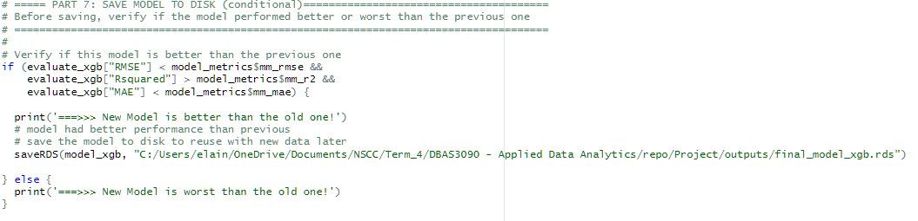
Reusing XGBoost model 7. Saving model to disk (conditional)

Slide 47
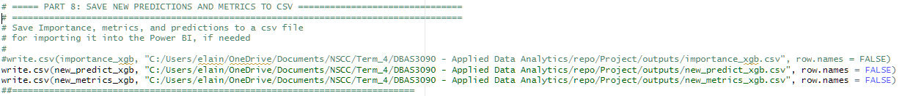
Reusing the Model Code 8. Saving dataframes to csv

Slide 48
Live Demo
New Data Downloading
New Prediction with Saved ML Model
MS Power BI Pages Navigation

Slide 49
Power BI
Statistics Overview
Performance
Profitability
Consumer Cyclical Comparison
Communication Services Comparison
Ticker & Indexes Comparison timeline (S&P500, Nasdaq, and Dollar)
Ticker & Indexes Correlation
Ticker Candlestick & Volume
Ticker Moving Average & Volatility

Slide 50
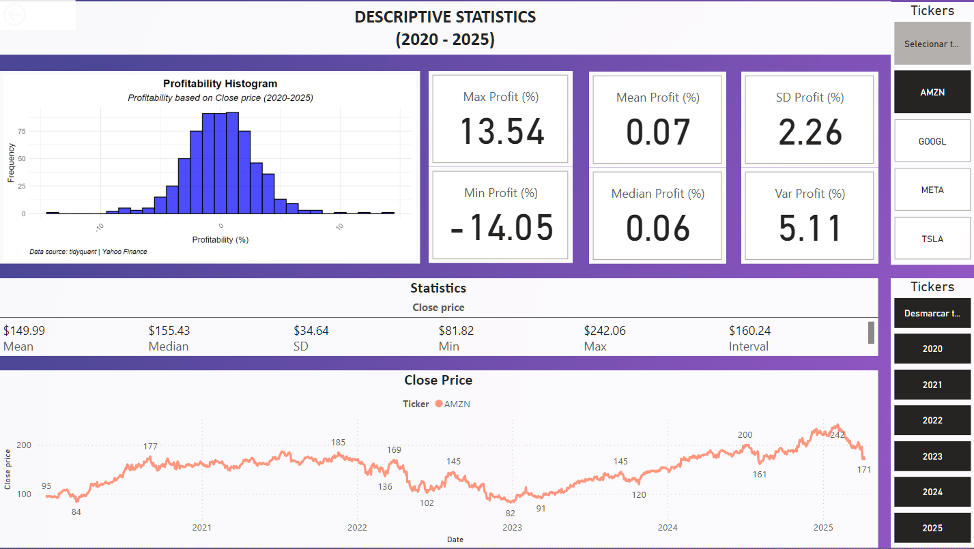
Statistics Overview
KPI = (1 – (manual interventions/ total executions)) * 100

Slide 51
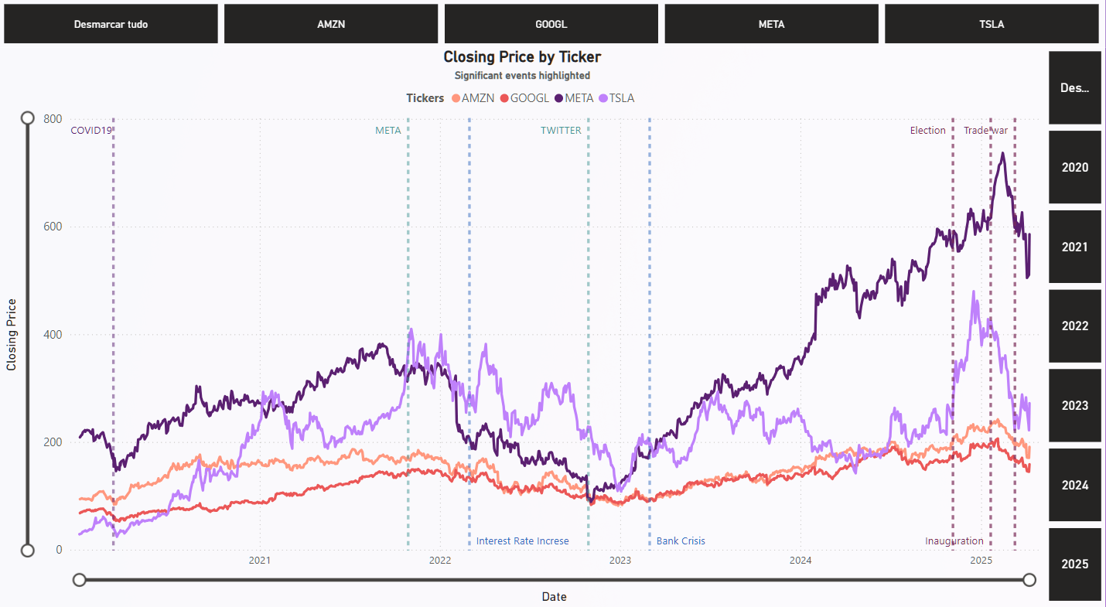
Performance (events effect)

Slide 52
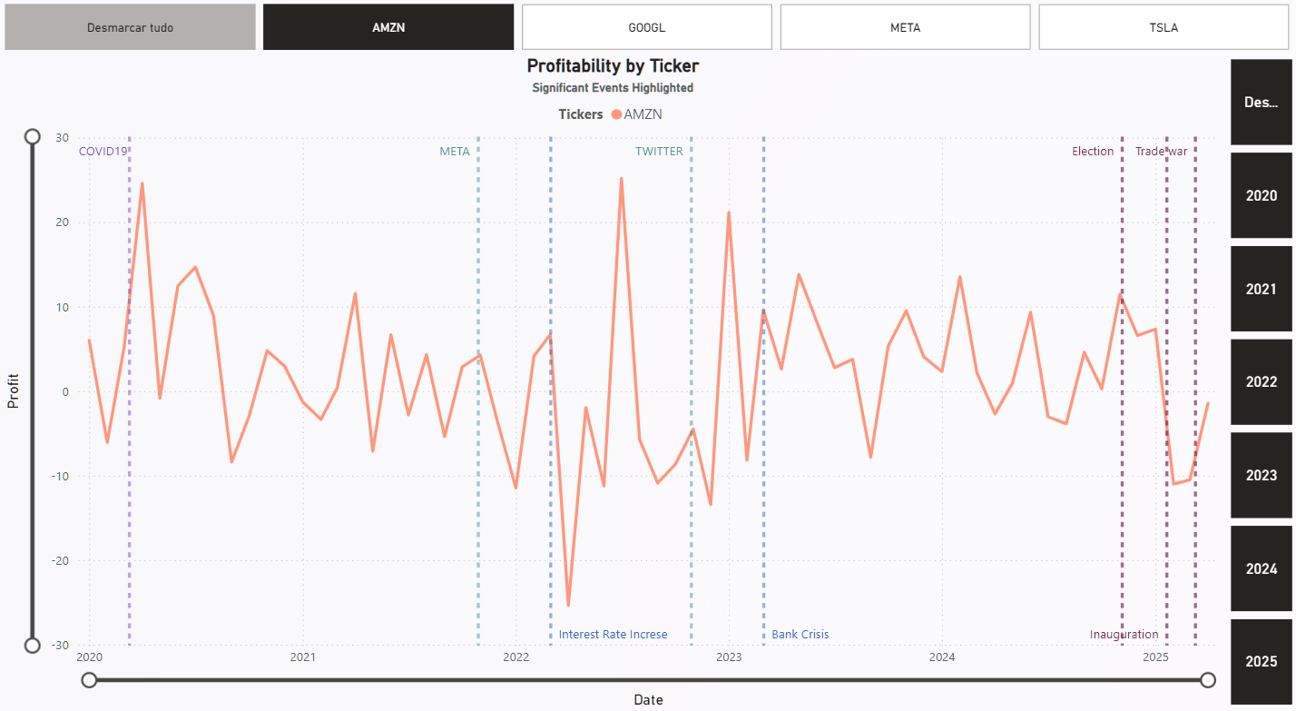
Profitability

Slide 53
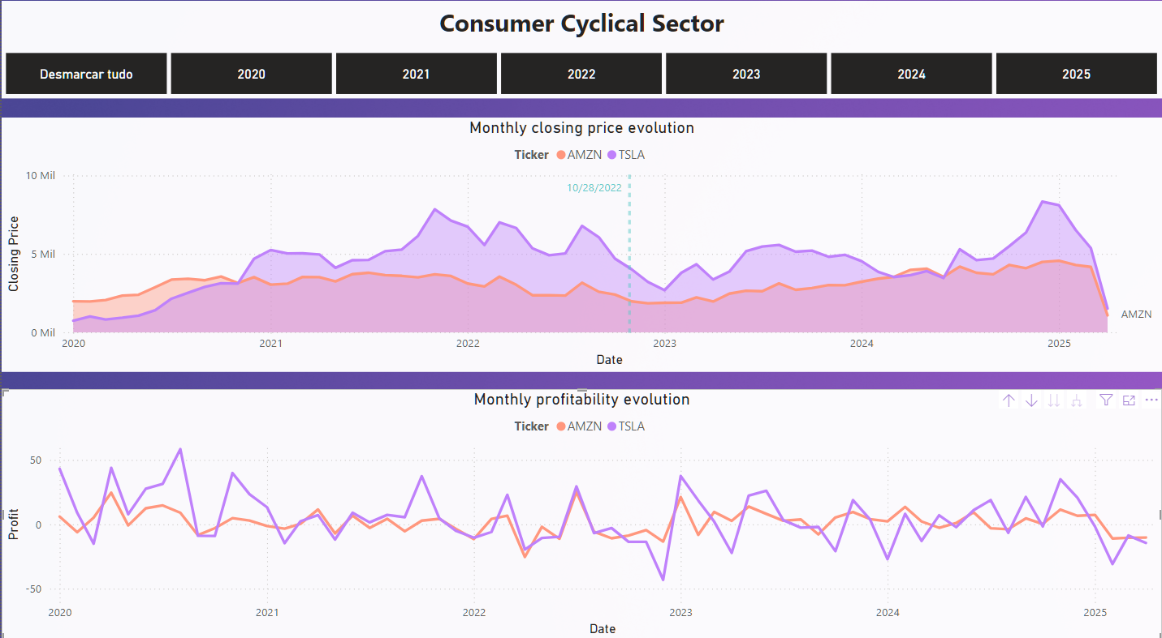
Consumer Cyclical Comparison

Slide 54
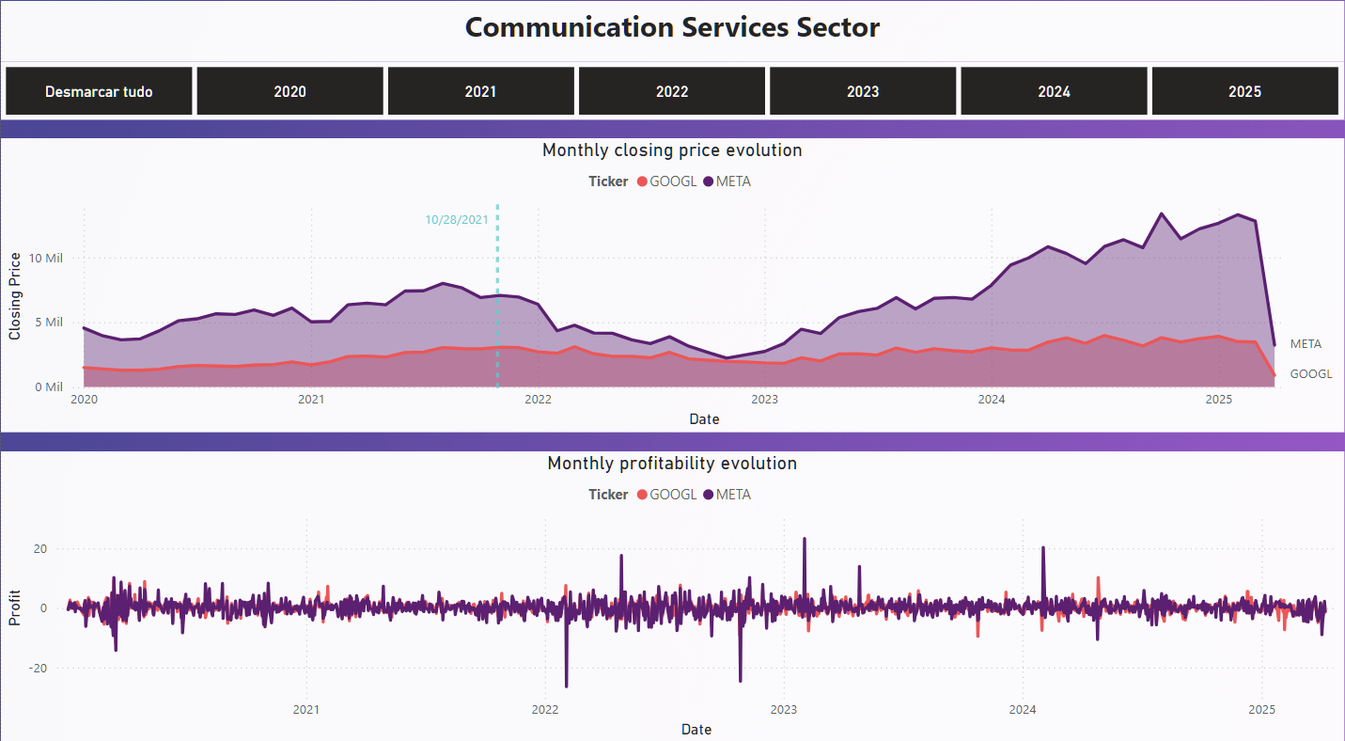
Communication Services Comparison

Slide 55
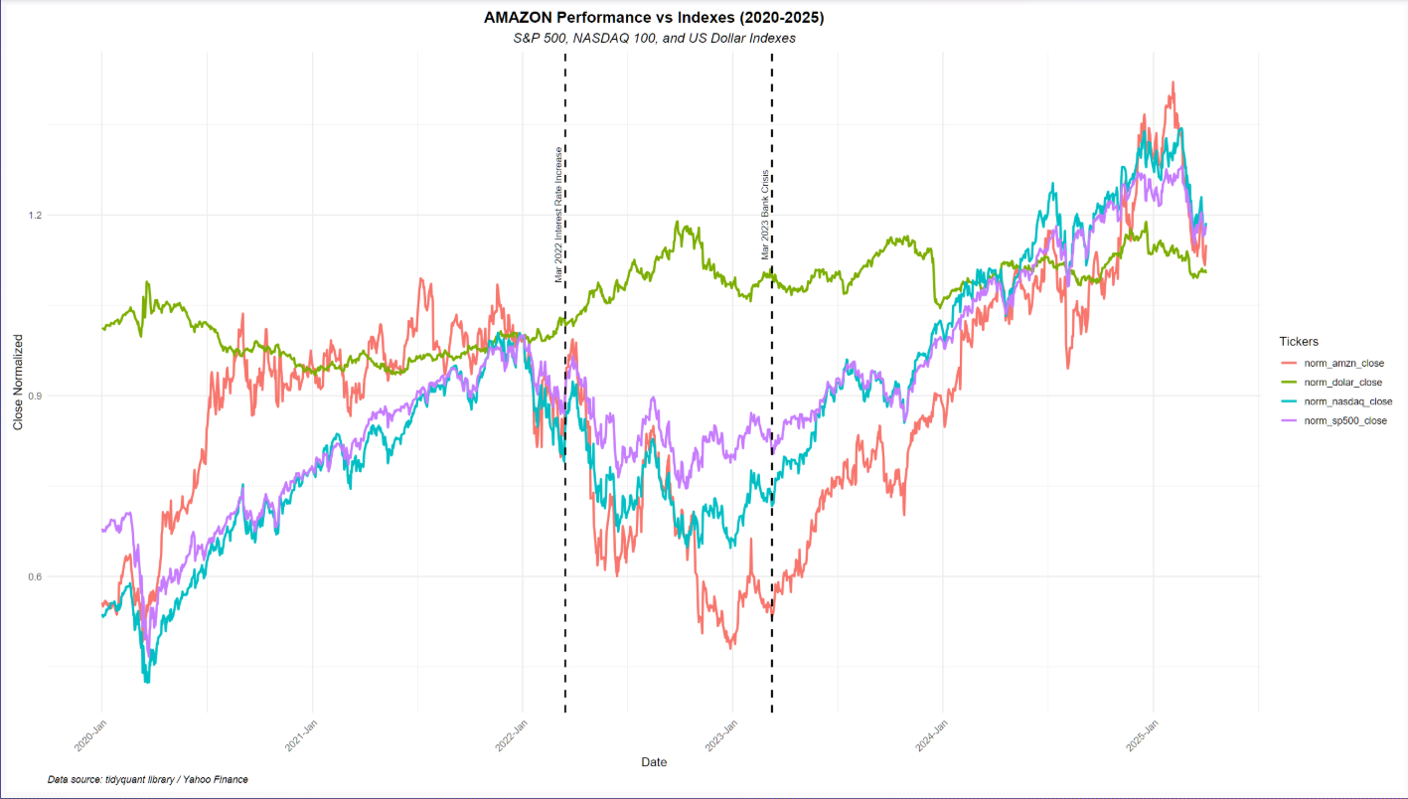
Amazon & Indexes Comparison S&P500, Nasdaq, Dollar

Slide 56
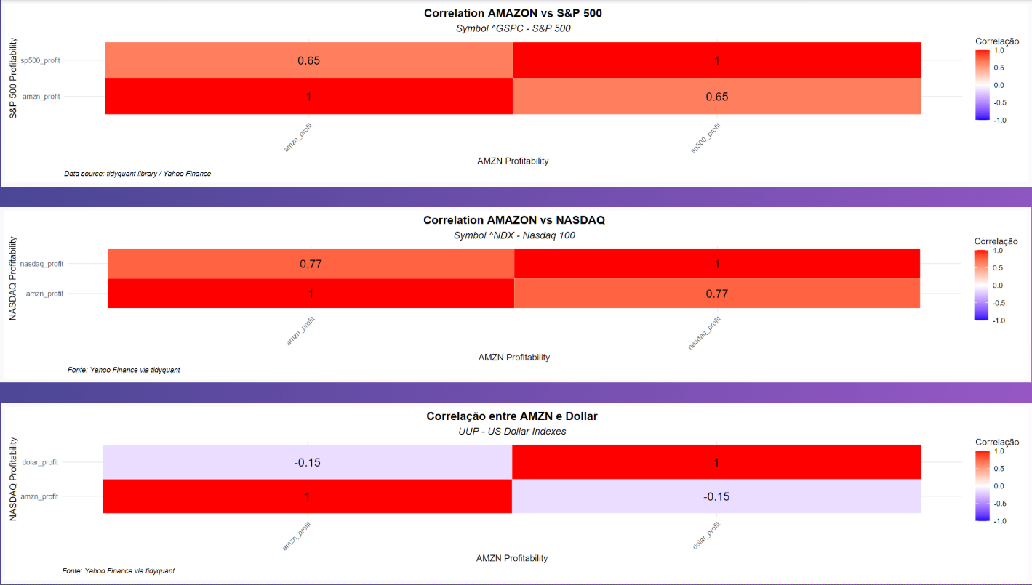
Amazon & Indexes Correlation

Slide 57
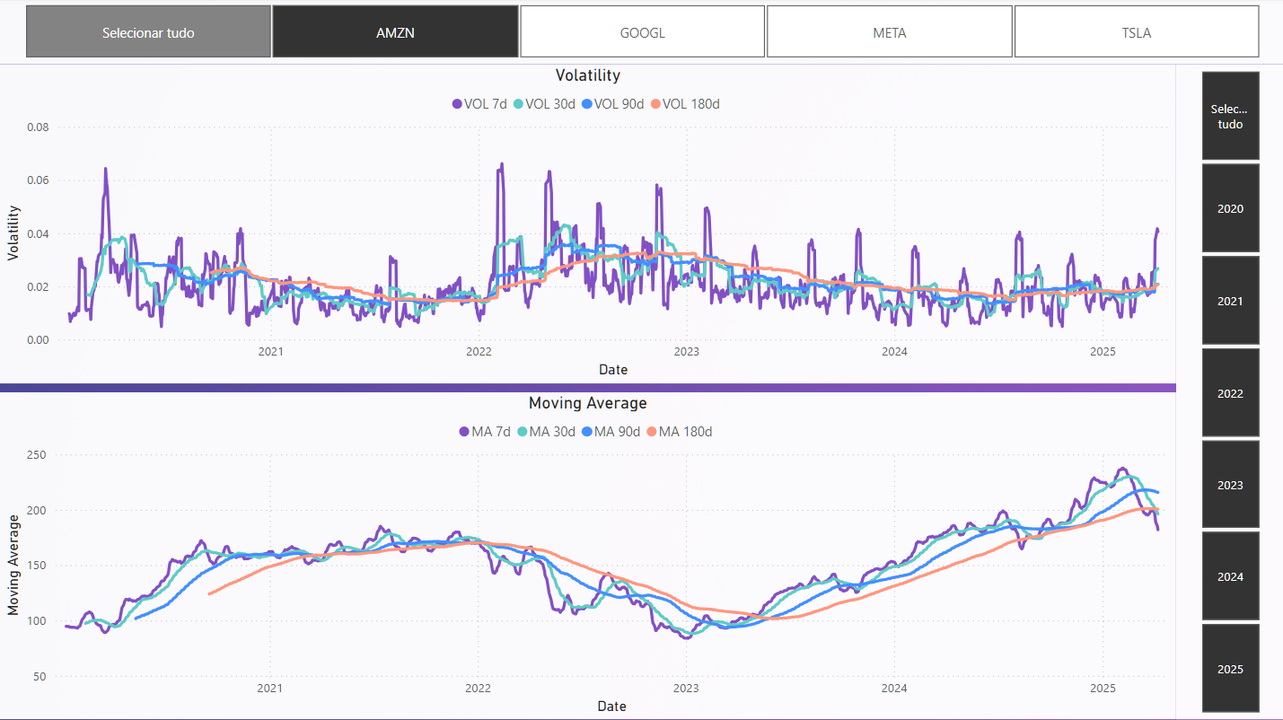
Moving Average & Volatility

Slide 58
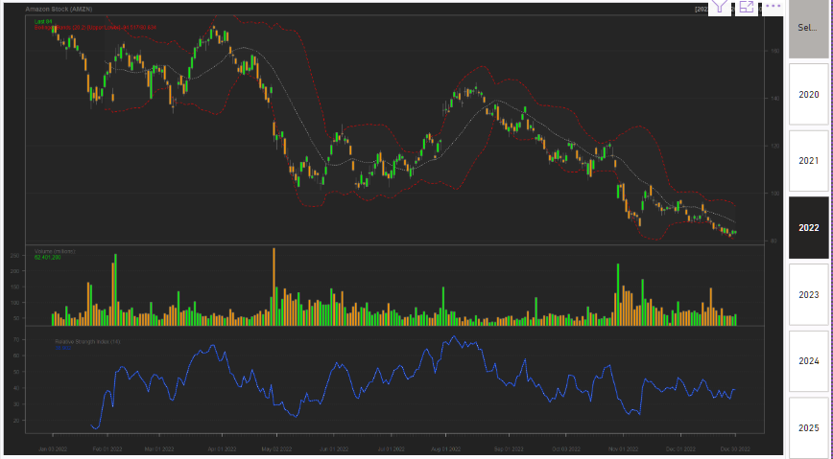
Amazon Candlestick and Volume

Slide 59
Thank You

Slide 60
References
Are there packages that allow you to analyse stock prices using R just like Python? (n.d.). Quora. Retrieved April 13, 2025, from https://www.quora.com/Are-there-packages-that-allow-you-to-analyse-stock-prices-using-R-just-like-Python
Brownlee, J. (2019, August 22). Save And Finalize Your Machine Learning Model in R. MachineLearningMastery.com. Retrieved April 13, 2025, from https://machinelearningmastery.com/finalize-machine-learning-models-in-r/
Core Functions in tidyquant. (n.d.). Retrieved April 13, 2025, from https://business-science.github.io/tidyquant/articles/TQ01-core-functions-in-tidyquant.html
Data Visualization. (n.d.). Retrieved April 13, 2025, from https://socviz.co/makeplot.html#makeplot
Davidiseminger. (n.d.). Run R scripts in Power BI Desktop - Power BI. Microsoft Learn. Retrieved April 13, 2025, from https://learn.microsoft.com/en-us/power-bi/connect-data/desktop-r-scripts
Fix, B. (2022, November 13). Tidyquant: An Open-Access Tool for Studying the Stock Market. Economics From the Top Down. Retrieved April 13, 2025, from https://economicsfromthetopdown.com/2021/09/18/tidyquant-an-open-access-tool-for-studying-the-stock-market/
Package index. (n.d.). Retrieved April 13, 2025, from https://ggplot2.tidyverse.org/reference/#geoms
Robbins, Z. B. J. (2019, March 14). 21 Stock data with tidyquant | edav.info/. Retrieved April 13, 2025, from https://jtr13.github.io/EDAVold/tidyquant.html
RPubs - Analyzing Performance with Tidyquant. (n.d.). Retrieved April 13, 2025, from https://rpubs.com/shaye-thyne/finModelingQuiz5_a
RPubs - XGBoost Iris Classification Example in R. (n.d.). Retrieved April 13, 2025, from https://rpubs.com/dalekube/XGBoost-Iris-Classification-Example-in-R
tidyquant package - RDocumentation. (n.d.). Retrieved April 13, 2025, from https://www.rdocumentation.org/packages/tidyquant/versions/1.0.11
VanMSFT. (n.d.). Quickstart: Run R scripts - SQL machine learning. Microsoft Learn. Retrieved April 13, 2025, from https://learn.microsoft.com/en-us/sql/machine-learning/tutorials/quickstart-r-create-script?view=sql-server-ver16

